Slide 1
Artificial Intelligence (AI)
Topic 2: Problem Solving Agents (Part -VI)

Slide 2
Agenda
Uninformed Search Algorithms
Learning Outcomes : Searching Algorithms
Methodology and Assessment Criteria for the Subject

Slide 3
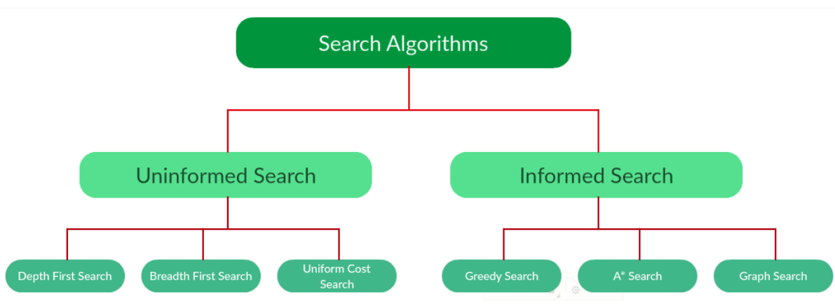
Types of Search Algorithms

Slide 4
Searching Strategies
Blind search → traversing the search space until the goal nodes is found (might be doing exhaustive search).
Techniques : Breadth First Uniform Cost ,Depth first, Interactive Deepening search.
Guarantees solution.
Heuristic search → search process takes place by traversing search space with applied rules (information).
Techniques: Greedy Best First Search, A* Algorithm
There is no guarantee that solution is found.

Slide 5
Example: Traveling Salesperson Problem
Suppose a salesperson has five cities to visit and them must return home. Goal → find the shortest path to travel.
A
B
75
125
125
100
75
E
50
125
C
50
D
100

Slide 6
Measuring Searching Performance
The output from problem-solving (searching) algorithm is either FAILURE or SOLUTION.
Four ways:
Completeness : is guaranteed to find a solution?
Optimality: does it find optimal solution ?
Time complexity: how long?
Space complexity: how much memory?
Complexity : branching factor (b), depth (d), and max. depth (m)

Slide 7
Breadth-First Search (1)
A Directed graph BFS Algorithm

Slide 8
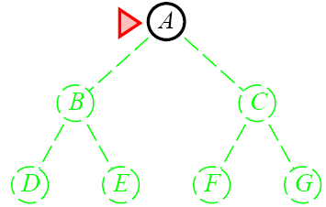
Breadth-First Search

Slide 9
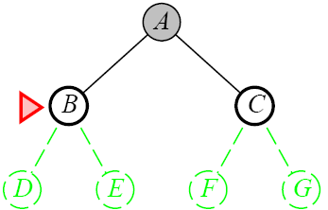
Breadth-First Search

Slide 10
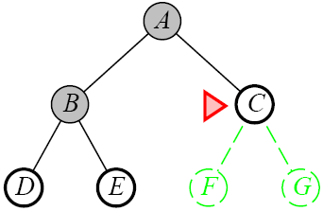
Breadth-First Search

Slide 11
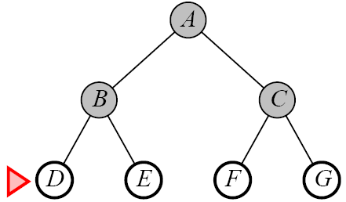
Breadth-First Search

Slide 12
Depth-First Search
Complete
No: fails in infinite-depth spaces, spaces with loops
Modify to avoid repeated spaces along path
Yes: in finite spaces
Time
O(b^{m})
Not great if m is much larger than d
But if the solutions are dense, this may be faster than breadth-first search
Space
O(bm)…linear space
Optimal
No

Slide 13
Learning Outcomes with the Topic
Understanding the need of Search Algorithms

Slide 14
Methodology And Assessment Criterias
Class Assignment(s)
Each chapter being covered will have one assignment. The Case Studies will be given in line to the Changing with Speed across IT Projects in Kirirom
Internal Exam(s)
There will be 2 exams
Model Exam
There will be one Model Exam.
Semester Exam
There will be 1 Semester Exam

Slide 15
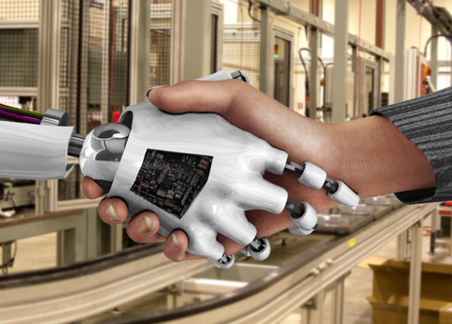
Thank You !
“An Algorithm Must Be Seen to Be Believed”
- Donald Knuth

